Slide 1


Employee Salary Prediction Using Machine Learning
Accurately predicting employee salary is now crucial for workforce planning and talent retention. Organizations use these insights for performance evaluations and incentive plans.
Our project predicts salary using metrics .This tool helps HR forecast compensation, spot anomalies, and design data-backed incentive plans.
by Chandini Ashok G
Clickhere

Slide 2

Project Objective
Primary Goal
Predict employee salary based on business and performance metrics with high accuracy
Key Features
Total Sales, Bonus, Base Pay, Unit Price, Volume, Months Worked, and other business indicators
Expected Outcome
A robust and interpretable machine learning model that provides insights into factors affecting salary determination

Slide 3
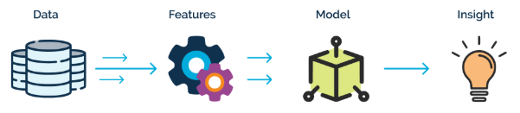


Techniques Used
Exploratory Data Analysis
Understanding data distribution and identifying outliers to prepare for modeling
Model Building
Training multiple machine learning models including Linear Regression, Ridge, Random Forest, and XGBoost
Feature Engineering
Handling multicollinearity, scaling features, and selecting top predictors
Model Evaluation
Using metrics like R2 Score, MSE, MAE, and hyperparameter tuning with GridSearchCV

Slide 4

Data Preprocessing
Data Loading
Loaded HR dataset with 5000 rows and 20 columns including salary and performance metrics
Missing Value Handling
Identified and imputed missing values in Base_pay (23), openingbalance (1476), and Total_Sales (8) using median imputation
Categorical Encoding
Converted categorical variables like Gender, Rating, Calls, Billing, Dependancies, and Type using LabelEncoder
Outlier Treatment
Applied Winsorization to handle outliers by limiting extreme values to reduce their effect on the model

Slide 5
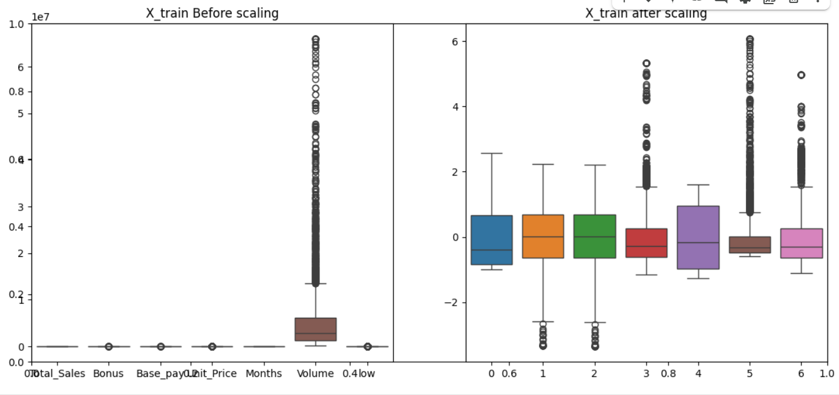
Feature Selection and Scaling
Feature Selection
Selected key predictors: Total_Sales, Bonus, Unit_Price, Months, Volume, and Low
Train-Test Split
Split data into 80% training (4000 samples) and 20% testing (1000 samples)
Standardization
Applied StandardScaler to normalize features for better model performance

Slide 6
Model Performance Comparison
1.2
0.8
0.4
0
Random Forest Linear Regression XGBoost RidgeCV LassoCV
The Random Forest model achieved the highest R2 score of 0.9995, indicating it explains 99.95% of the variance in salary predictions.
Linear Regression and XGBoost tied for second place with 0.9980, while LassoCV performed poorly with only 0.0732.

Slide 7

Random Forest Optimization
Best Performance
R2 Score: 0.9994 on test data
Hyperparameter Tuning
Randomized SearchCV with 5-fold cross-validation
Optimal Parameters
n_estimators=100, max_depth=20, min_samples_leaf=1
After identifying Random Forest as the best performing model, we further optimized it through hyperparameter tuning.
The tuned model achieved an impressive R2 score of 0.9996 on training data and 0.9994 on testing data, demonstrating excellent generalization without overfitting.

Slide 8
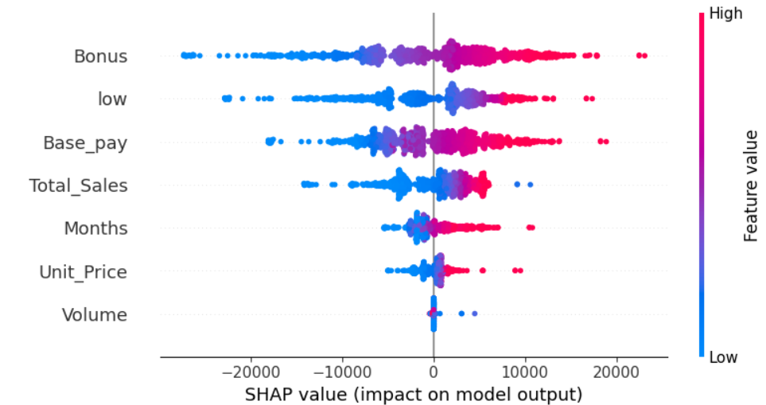
Feature Importance Analysis
Bonus, Total Sales, and Base Pay emerged as the top drivers influencing Salary prediction.
These features showed the highest contribution to the model's decision-making, as identified through SHAP feature importance analysis.

Slide 9
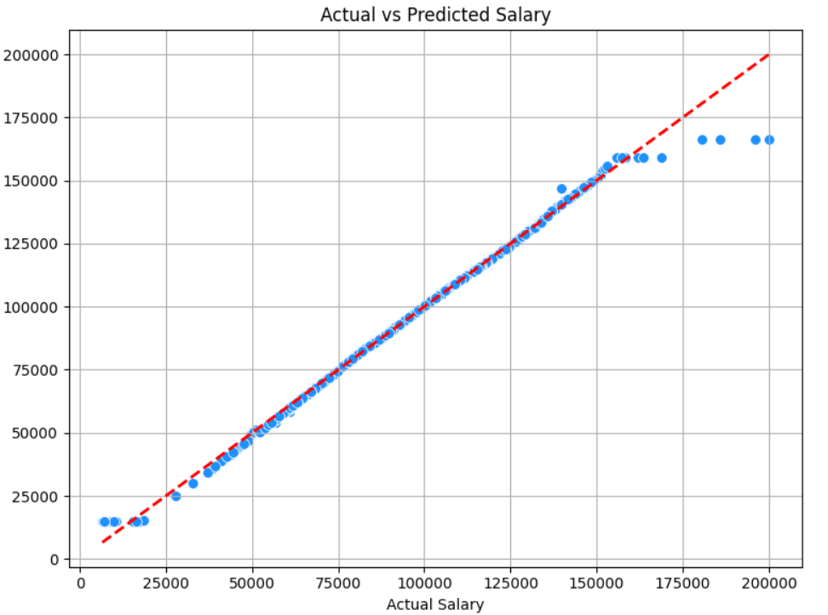
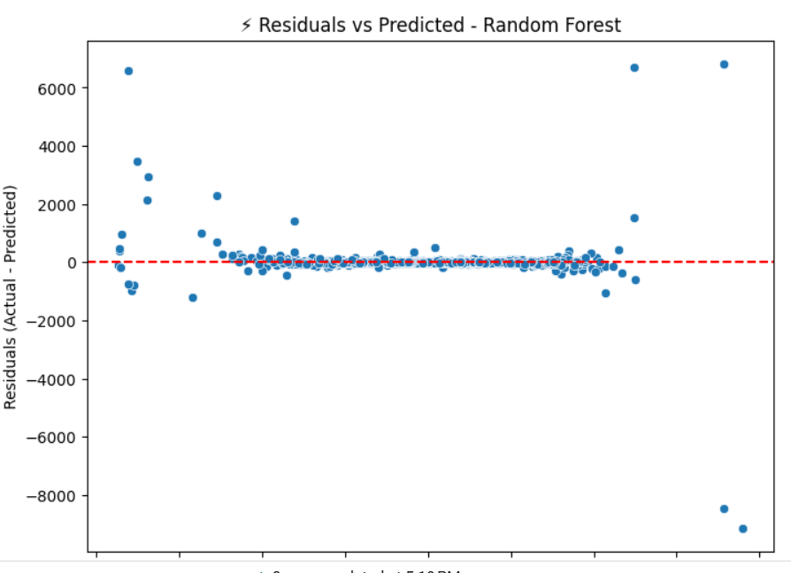
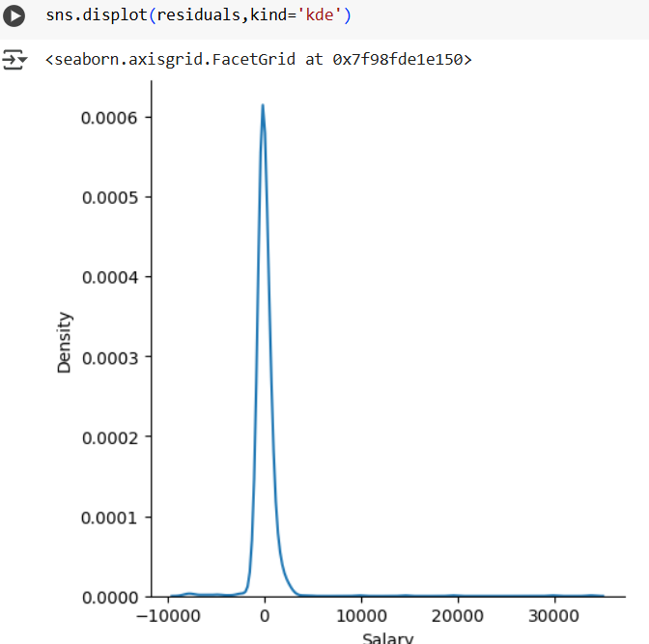
Model Validation and Assumptions
LINEARITY
Actual vs Predicted
-Points clustered tightly along the diagonal line indicate high prediction accuracy, with minimal deviation between actual and predicted salary values.
HOMOSCEDASTICITY
Residual Analysis
Residuals (differences between actual and predicted values).ensures a uniform Varience of residuals
Distribution of Residuals
The bell-shaped distribution of residuals confirms they follow a normal distribution, further validating the model's statistical soundness.

Slide 10

Conclusions and Applications
High Accuracy Achieved
The Random Forest model achieved 99.94% accuracy in predicting salaries based on performance metrics
Key Insights
Bonus, Total Sales, and Months worked are the most influential factors in salary determination
HR Applications
Model enables data-driven compensation planning, anomaly detection, and fair incentive structures

Slide 11

Thank You
Thank you for your time. We hope this presentation offered useful insights into our salary prediction model
CHANDINI ASHOK

